Slide 1
Potential Energy

Slide 2
By the end of this lesson, you should be able to do the following:
Identify and describe the three types of potential energy.
Distinguish potential energy from kinetic energy.

Slide 3
Potential energy is also known as stored energy, because it is stored in objects.
Lots of things have potential energy!
For example, your phone and laptop have batteries that store energy for the devices to use. Food has potential energy that we take when we eat it.

Slide 4
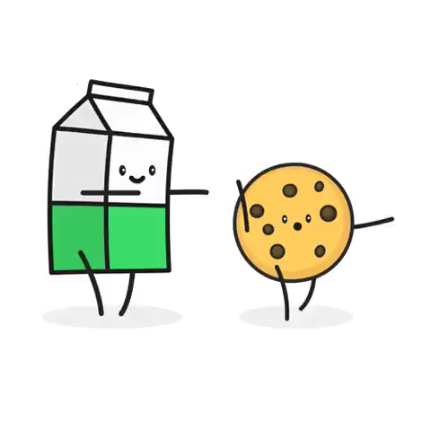
Your food and drink are turned into energy when you eat, and the energy is stored in your body.
The energy is used when you produce kinetic energy - moving, or speaking, or just warming yourself up.

Slide 5
There are three main types of potential energy:
Chemical potential energy, which is stored in the chemical bonds between atoms.
Elastic potential energy, which is stored in stretchable materials (such as springs).
Gravitational potential energy, which is stored in objects that are experiencing gravity.

Slide 6

An object that is experiencing gravity has gravitational potential energy (GPE).
Every object on the Earth has GPE, because everything is attracted to the Earth's centre.
This energy is converted into kinetic energy when an object moves downwards.

Slide 7

The gravitational potential energy (GPE) of an object depends on its mass and its height above the ground.
This means that larger and higher objects have more energy to fall with than those that are smaller or closer to the ground.

Slide 8
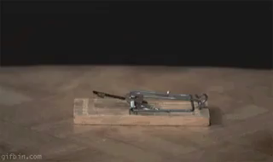
Some objects can be stretched. When they are stretched, energy is put into the object and stored as potential energy.
It is then released as kinetic energy when the object is returned to its usual form.
This is elastic potential energy.

Slide 9
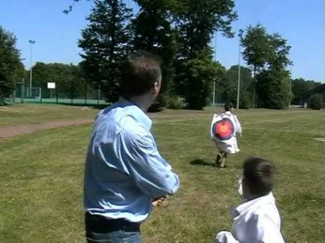
Elastic potential energy is the energy stored in an elastic material or spring when compressed or extended.

Slide 10
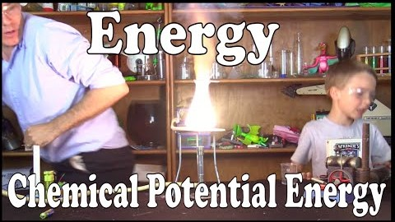
Chemical potential energy is the energy stored within objects, created when atoms and molecules bond.
Chemical bonds are like the glue which holds particles together, and each bond contains a lot of energy.

Slide 11


